Slide 1
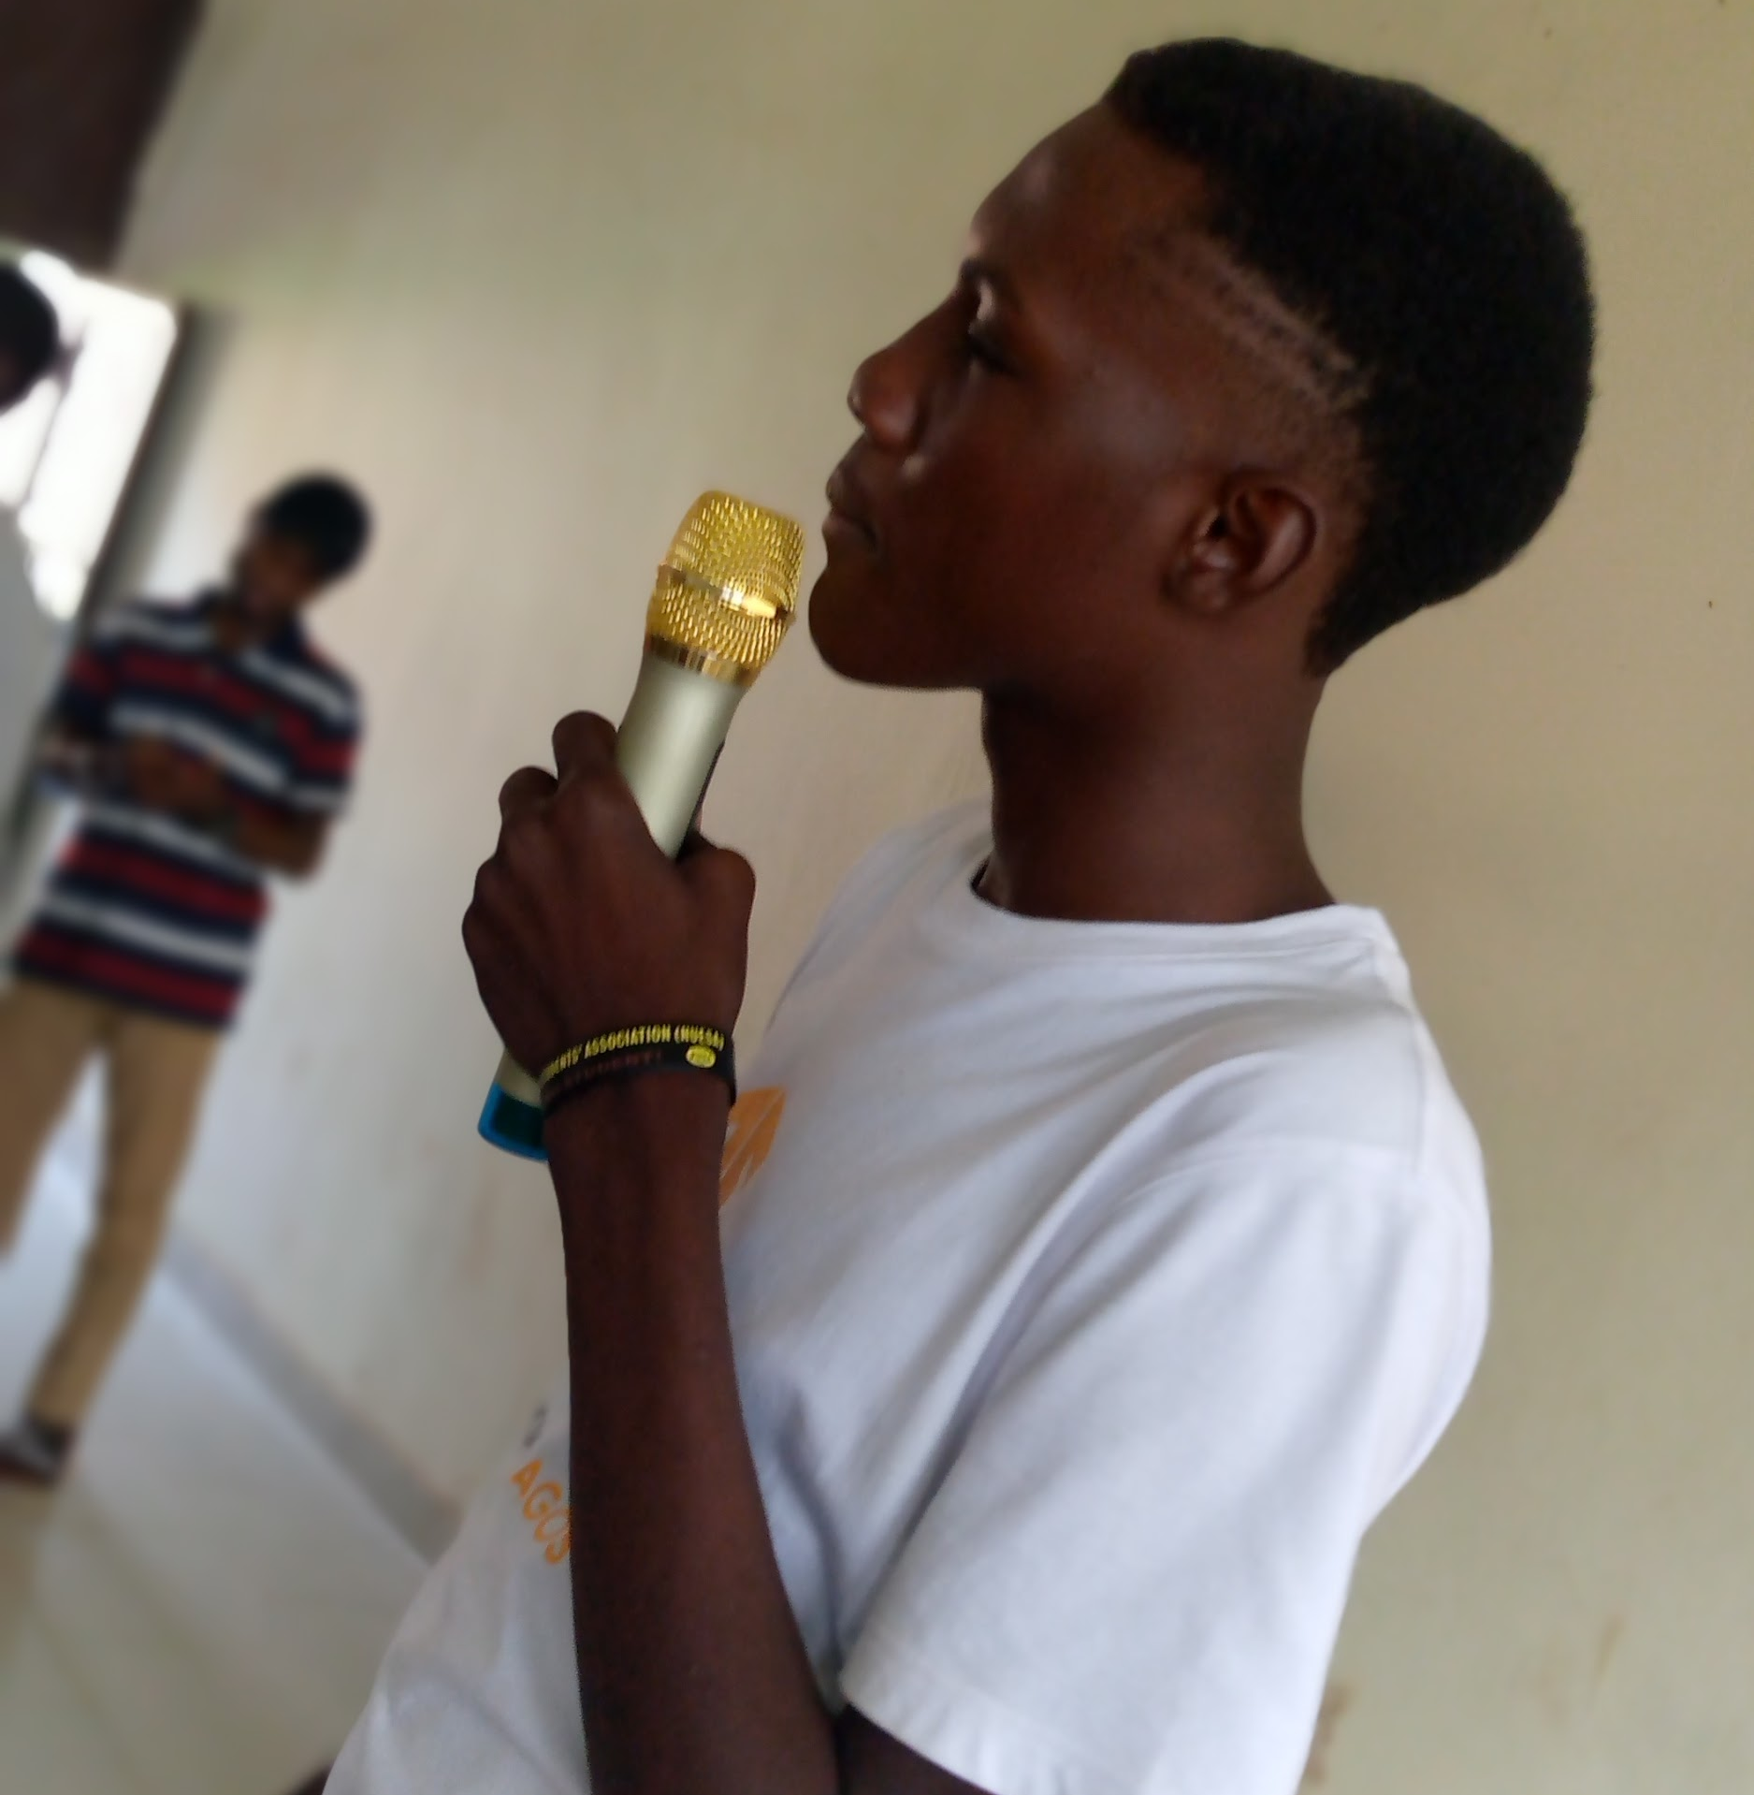

Introduction To GIT
Exploring Version Control System
Daramola David Oluwadamifogore
DSC futa
@Henginnearher_D

Slide 2
Version Control System

Slide 3
What is VCS.
Version Control System
A version control system, or VCS, tracks the history of changes as people and teams collaborate on projects together. As the project evolves, teams can run tests, fix bugs, and contribute new code with the confidence that any version can be recovered at any time.

Slide 4
Developers can review project history to find out:
Which changes were made?
Who made the changes?
When were the changes made?
Why were changes needed?

Slide 5
Open Source

Slide 6
Open Source.
Open-source software (OSS) is any computer software that's distributed with its source code available for modification. That means it usually includes a license for programmers to change the software in any way they choose: They can fix bugs, improve functions, or adapt the software to suit their own needs.

Slide 7
“Open source can propagate to fill all the nooks and crannies that people want it to fill.”
Mitch Kapor

Slide 8
Distributed Version Control System

Slide 9
What is DVCS.
Distribution Version Control System
Git is an example of a distributed version control system (DVCS) commonly used for open source and commercial software development. DVCSs allow full access to every file, branch, and iteration of a project, and allows every user access to a full and self-contained history of all changes.

Slide 10
Getting Started With GIT

Slide 11

GIT
GIT is a Version Control System for tracking changes in Computer files
Distributed Version Control
Coordinates work between multiple developers
Who made what changes and when
Revert back at any time
Local & remote repos

Slide 12
Concept of GIT
Keeps track of code history
Takes “snapshots” of your files
You decide when to take a snapshot by making a “Commit”
You can visit any snapshot at any time
You can stage files before commiting
Notes:
Snapshot is to a repository as screenshot is to a video.

Slide 13
Repository
a.k.a Repo
A repository, or Git project, encompasses the entire collection of files and folders associated with a project, along with each file’s revision history. The file history appears as snapshots in time called commits, and the commits exist as a linked-list relationship, and can be organized into multiple lines of development called branches.

Slide 14
BASIC COMMANDS
$ git init //Initialize Local Git repo
$ git add <file> // Add file to index
$ git staus // Check Status of working Tree
$ git commit //Commit Changes in index
$ git push //Push to Remote Repository
$ git pull // Pull from a Remote Repo
$ git clone //Creates local copy of remote projects
$ git branch //Shows branch you are working on
$ git merge // Used to join
Notes:
Snapshot is to a repository as screenshot is to a video.

Slide 15
CODE

Slide 16
hp@Engineer-D MINGW64 ~/Desktop/git
$ git --version >> git version 2.19.1.windows.1
hp@Engineer-D MINGW64 ~/Desktop/git
$ git config --global user.name "Engineer-D"
hp@Engineer-D MINGW64 ~/Desktop/git
$ git config --global user.email "dami04glory@gmail.com"
hp@Engineer-D MINGW64 ~/Desktop/git
$ touch helloworld.py
hp@Engineer-D MINGW64 ~/Desktop/git
$ touch vowel.py

Slide 17
hp@Engineer-D MINGW64 ~/Desktop/git
$ git init >> Initialized empty Git repository in C:/Users/hp/Desktop/git/.git/
hp@Engineer-D MINGW64 ~/Desktop/git
$ git config --global user.name "Davido"
hp@Engineer-D MINGW64 ~/Desktop/git
$ git config --global user.email "dami04glory@gmail.com"
hp@Engineer-D MINGW64 ~/Desktop/git
$ git add vowel.py
hp@Engineer-D MINGW64 ~/Desktop/git
$ git status

Slide 18
hp@Engineer-D MINGW64 ~/Desktop/git
$ git status
On branch master
No commits yet
Changes to be committed:
(use "git rm --cached <file>..." to unstage)
new file: vowel.py
Untracked files:
(use "git add <file>..." to include in what will be committed)
helloworld.py

Slide 19
hp@Engineer-D MINGW64 ~/Desktop/git
$ git rm --cached vowel.py
rm 'vowel.py'
hp@Engineer-D MINGW64 ~/Desktop/git
$ git status
On branch master
No commits yet
Untracked files:
(use "git add <file>..." to include in what will be committed)
helloworld.py
vowel.py
nothing added to commit but untracked files present (use "git add" to track)

Slide 20
hp@Engineer-D MINGW64 ~/Desktop/git
$ git add *.py
hp@Engineer-D MINGW64 ~/Desktop/git
$ git status
On branch master
No commits yet
Changes to be committed:
(use "git rm --cached <file>..." to unstage)
new file: helloworld.py
new file: vowel.py

Slide 21
hp@Engineer-D MINGW64 ~/Desktop/git
$ git rm --cached *.py
rm 'helloworld.py'
rm 'vowel.py'
hp@Engineer-D MINGW64 ~/Desktop/git
$ git add .
hp@Engineer-D MINGW64 ~/Desktop/git
$ git status
On branch master
No commits yet
Changes to be committed:
(use "git rm --cached <file>..." to unstage)
new file: helloworld.py
new file: vowel.py

Slide 22
hp@Engineer-D MINGW64 ~/Desktop/git
$ git status
On branch master
No commits yet
Changes to be committed:
(use "git rm --cached <file>..." to unstage)
new file: helloworld.py
new file: vowel.py
Changes not staged for commit:
(use "git add <file>..." to update what will be committed)
(use "git checkout -- <file>..." to discard changes in working directory)
modified: helloworld.py

Slide 23
hp@Engineer-D MINGW64 ~/Desktop/git
$ git add .
hp@Engineer-D MINGW64 ~/Desktop/git
$ git status
On branch master
No commits yet
Changes to be committed:
(use "git rm --cached <file>..." to unstage)
new file: helloworld.py
new file: vowel.py

Slide 24
hp@Engineer-D MINGW64 ~/Desktop/git
$ git commit -m "Initial Commit"
[master (root-commit) cf8ed6f] Initial Commit
2 files changed, 13 insertions(+)
create mode 100644 helloworld.py
create mode 100644 vowel.py
hp@Engineer-D MINGW64 ~/Desktop/git
$ git status
On branch master
nothing to commit, working tree clean

Slide 25
hp@Engineer-D MINGW64 ~/Desktop/git
$ touch .gitignore
hp@Engineer-D MINGW64 ~/Desktop/git
$ touch story.txt
hp@Engineer-D MINGW64 ~/Desktop/git
$ git add .
hp@Engineer-D MINGW64 ~/Desktop/git
$ git status
On branch master
Changes to be committed:
(use "git reset HEAD <file>..." to unstage)
new file: .gitignore
hp@Engineer-D MINGW64 ~/Desktop/git
$ git commit -m "added gitignore folder"
[master 2dfa3ba] added gitignore folder
1 file changed, 1 insertion(+)
create mode 100644 .gitignore

Slide 26
hp@Engineer-D MINGW64 ~/Desktop/git
$ git branch find_greatest
hp@Engineer-D MINGW64 ~/Desktop/git
$ git checkout find_greatest
Switched to branch 'find_greatest'
hp@Engineer-D MINGW64 ~/Desktop/git
$ touch greatest.py
hp@Engineer-D MINGW64 ~/Desktop/git
$ git add .
hp@Engineer-D MINGW64 ~/Desktop/git
$ git commit -m "Added Greastest number script"
[find_greatest d51e512] Added Greastest number script
3 files changed, 11 insertions(+), 1 deletion(-)
create mode 100644 greatest.py
create mode 100644 story.txt

Slide 27
hp@Engineer-D MINGW64 ~/Desktop/git
$ git checkout master
Switched to branch 'master'
hp@Engineer-D MINGW64 ~/Desktop/git
$ git merge find_greatest
Merge made by the 'recursive' strategy.
greatest.py | 8 ++++++++
helloworld.py | 3 ++-
story.txt | 1 +
3 files changed, 11 insertions(+), 1 deletion(-)
create mode 100644 greatest.py
create mode 100644 story.txt

Slide 28
GITHUB
...Remote Repository

Slide 29
GITHUB.
GitHub brings together the world's largest community of developers to discover, share, and build better software. From open source projects to private team ...

Slide 30

GITHUB
Benefits of GITHUB
It makes it easy to contribute to your open source projects
Documentation
Showcase your work
Markdown
GitHub is a repository
Track changes in your code across versions
Integration options
Notes:
Markdown
Markdown allows you to use a simple text editor to write formatted documents. GitHub has revolutionized writing by channeling everything through Markdown: from the issue tracker, user comments, everything. With so many other programming languages to learn for setting up projects, it’s really a big benefit to have your content inputted in a format without having to learn yet another system.
Integration options
GitHub can integrate with common platforms such as Amazon and Google Cloud, services such as Code Climate to track your feedback, and can highlight syntax in over 200 different programming languages

Slide 31
CODE

Slide 32
hp@Engineer-D MINGW64 ~/Desktop/git
$ git remote
hp@Engineer-D MINGW64 ~/Desktop/git
$ git remote add origin <url>
hp@Engineer-D MINGW64 ~/Desktop/git
$ git remote
origin
hp@Engineer-D MINGW64 ~/Desktop/git
$ git push -u origin master
hp@Engineer-D MINGW64 ~/Desktop/git
$ touch README.md
hp@Engineer-D MINGW64 ~/Desktop/git
$ git add .
hp@Engineer-D MINGW64 ~/Desktop/git
$ git commit -m “Added Readme”
hp@Engineer-D MINGW64 ~/Desktop/git
$ git push

Slide 33
hp@Engineer-D MINGW64 ~/Desktop/git
$ git clone <url>
hp@Engineer-D MINGW64 ~/Desktop/git
$ git pull
Already up-to-date

Slide 34

Thank You!
Daramola David Oluwadamifogore
DSCFUTA
@Henginnearher_D

